Slide 1
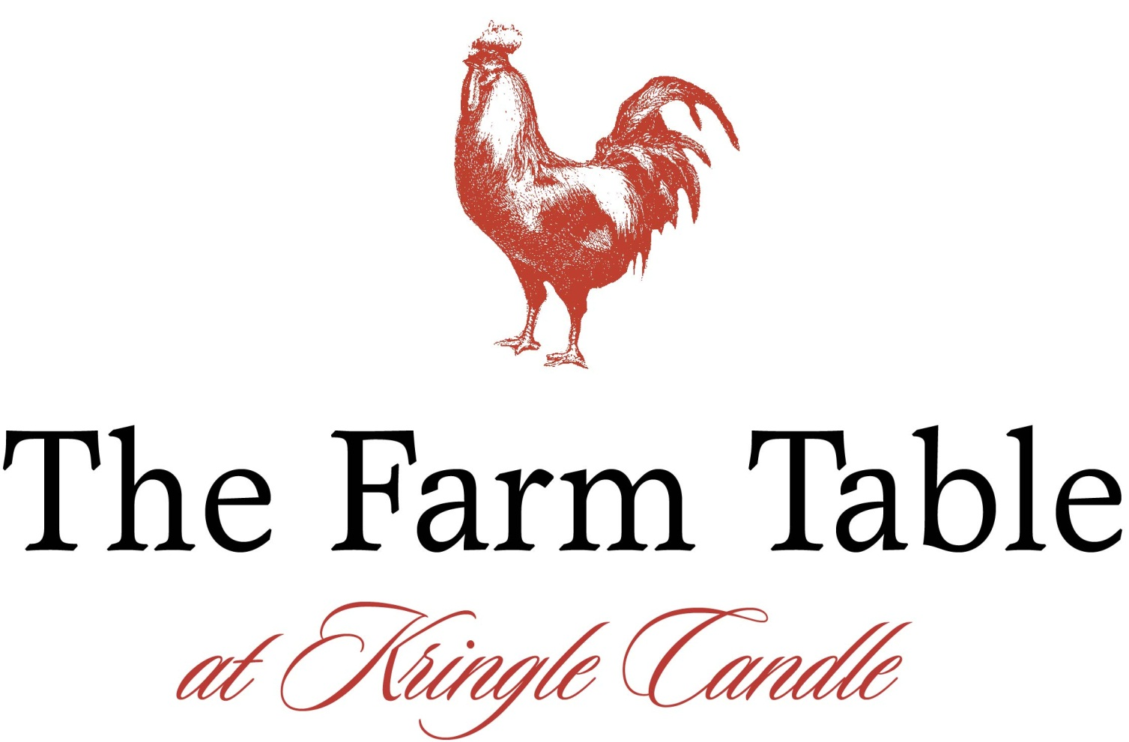
Executive Chef
Brent Menke
Notes:
This slide would be up right from the start, whether someone is introducing you or you just show up and begin on your own.

Slide 2
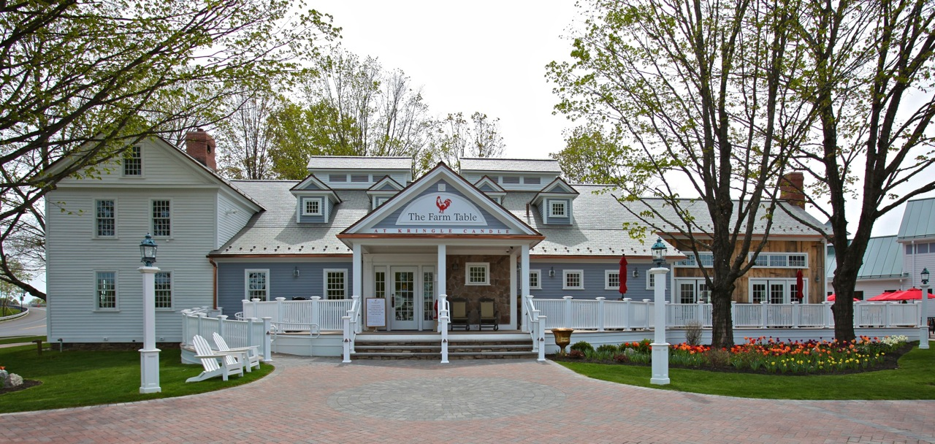
Notes:
If you’ve never been there, this IS The Farm Table. It’s a magnificent building and part of a wonderful operation, Kringle Candle. Let me tell you what makes a place like The Farm Table so special.

Slide 3
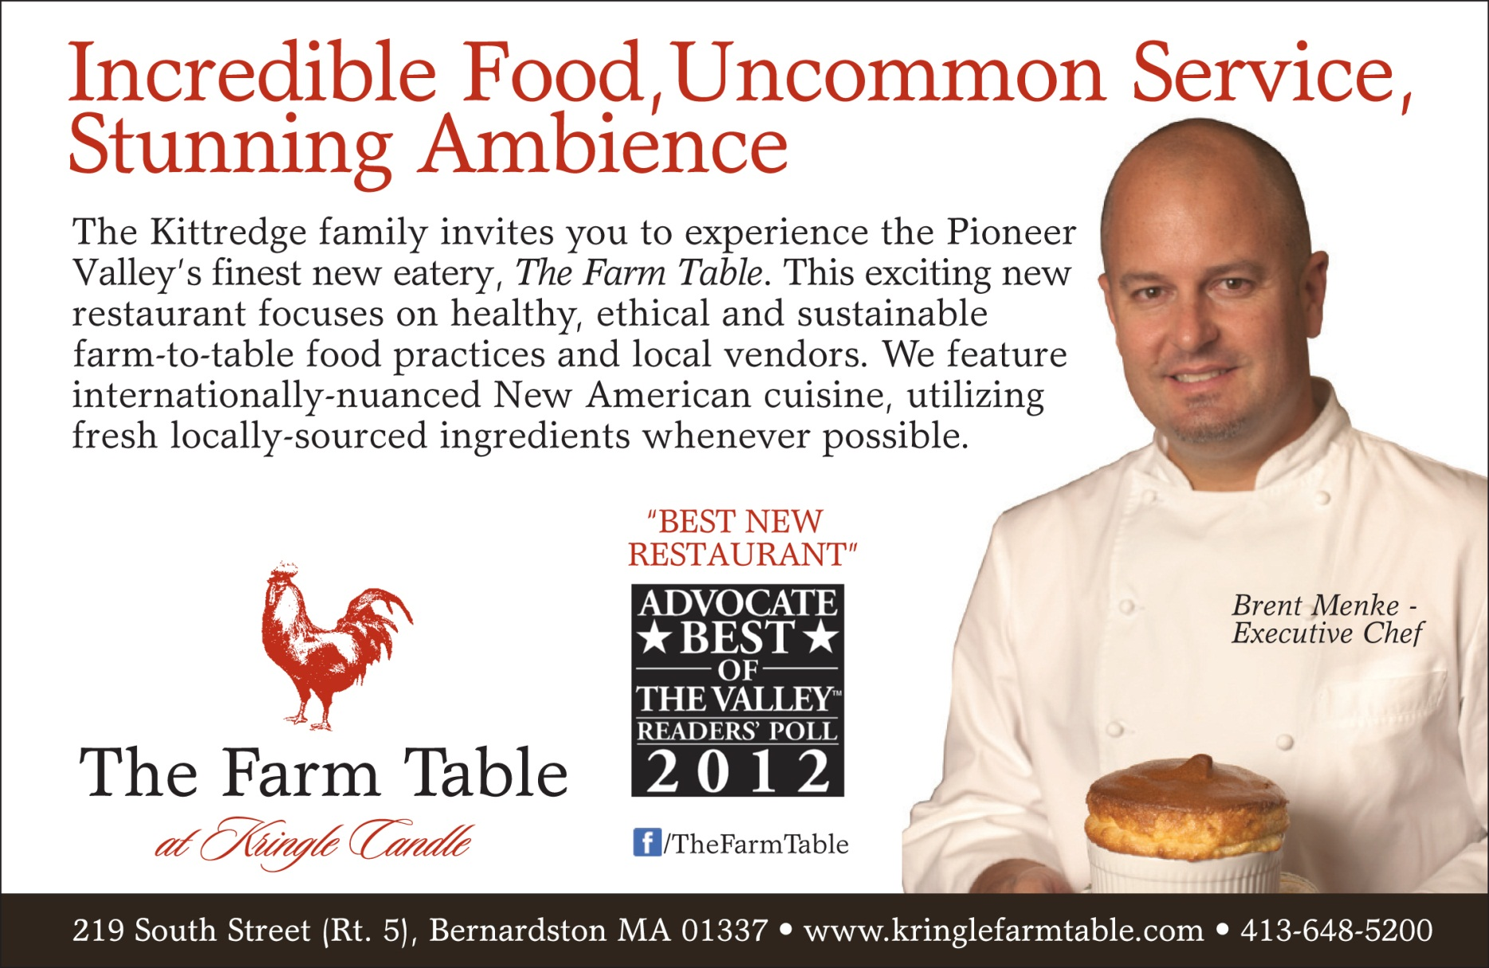
Notes:
Here’s our core message to potential guests. As you can see, we won the “Best New Restaurant” designation in April. But what’s key here is that the restaurant had barely been open 100 days when the ballotting closed. How does a restaurant win such a major honor on such a small sample size?

Slide 4

The Farm Table Vision
Our advertising says:
“Incredible Food, Uncommon Service,
Stunning Ambience”
How do we deliver on that promise?
Notes:
Well, that’s the basic theme of my talk today. What are the components of The Farm Table?

Slide 5
* Respect for our history
* A gracious, unpretentious setting
* Crafted foods, beautifully prepared and presented
* Food provenance – you know where it came from
* People with a passion for the details
* Organic where possible, gluten and peanut free options
* Local vendor partnerships – preserve jobs and land
* Ethical and sustainable practices
* Geothermal energy powers our building
* Re-purposed materials from original structure
* Innovative use of tableware, drinking vessels, etc.
* A firm commitment to “The Vision”
Notes:
Run through these quick – you’ll have time to expound on each one as you go.

Slide 6
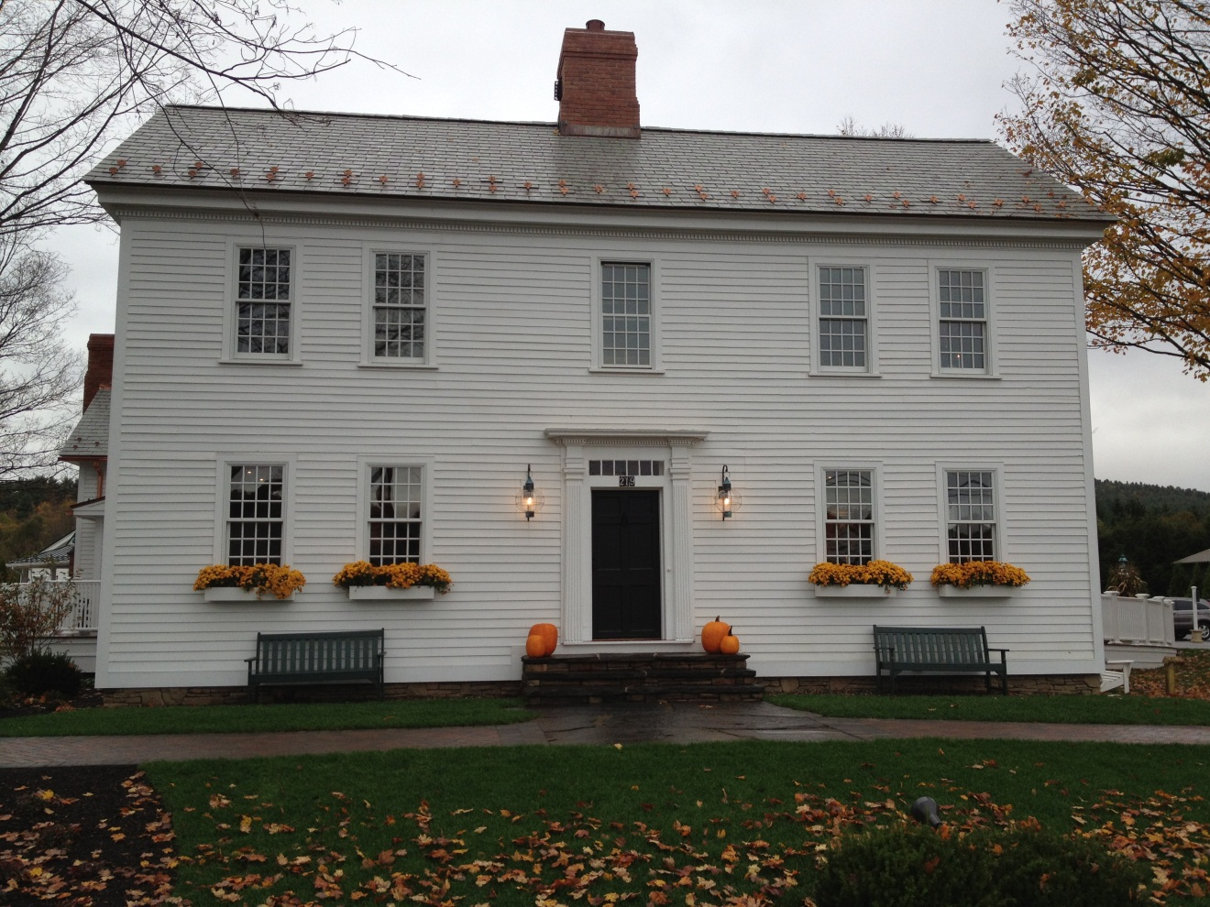
Respect for our history
The “old” part of the Farm Table was originally built in 1800 by the Hale family. It was operated as a dairy farm and expanded over the next 100+ years. We worked very hard to preserve as much of the main structure’s venerable look and feel as possible.

Slide 7
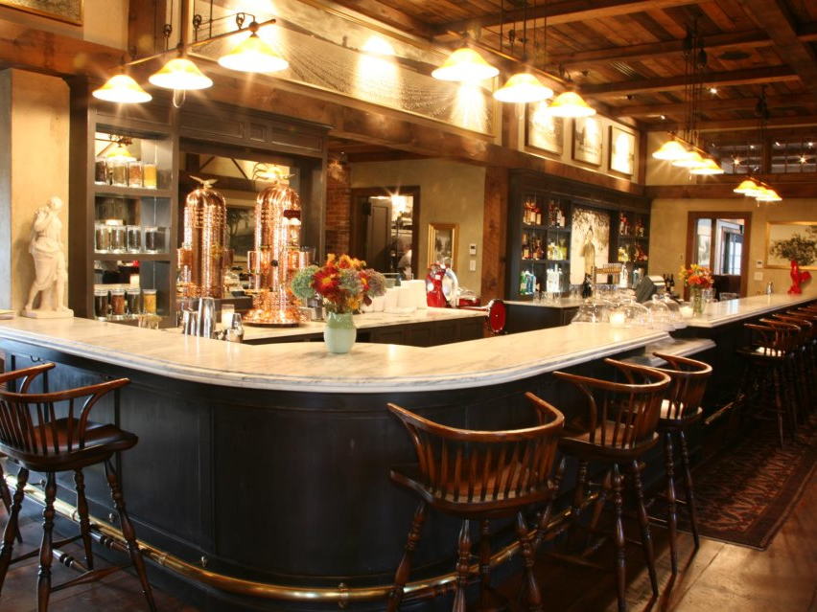
A gracious, unpretentious setting
The Farm Table’s interior is a welcoming environment, filled with agricultural antiquities and one of the longest marble bars in New England. It was quarried in Vermont.

Slide 8
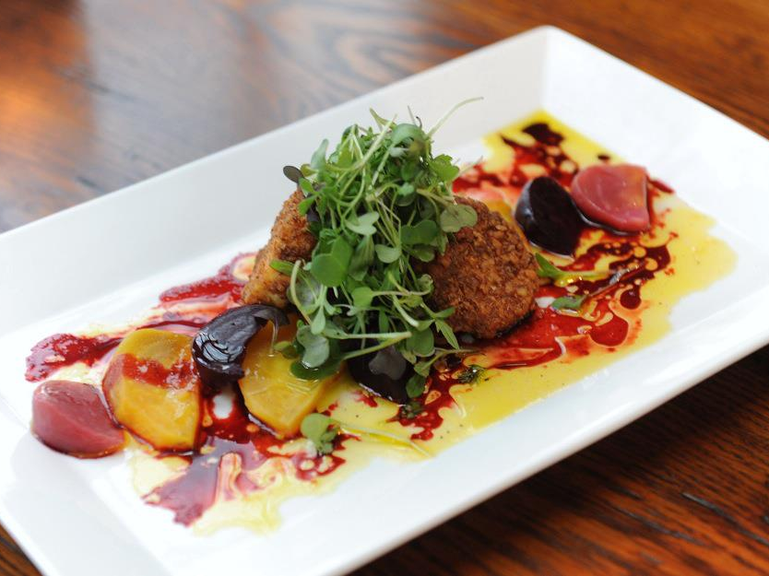
Crafted foods, beautifully prepared and presented
Our warm pecan crusted goat cheese and beet root salad with citrus vinaigrette and micro greens.

Slide 9
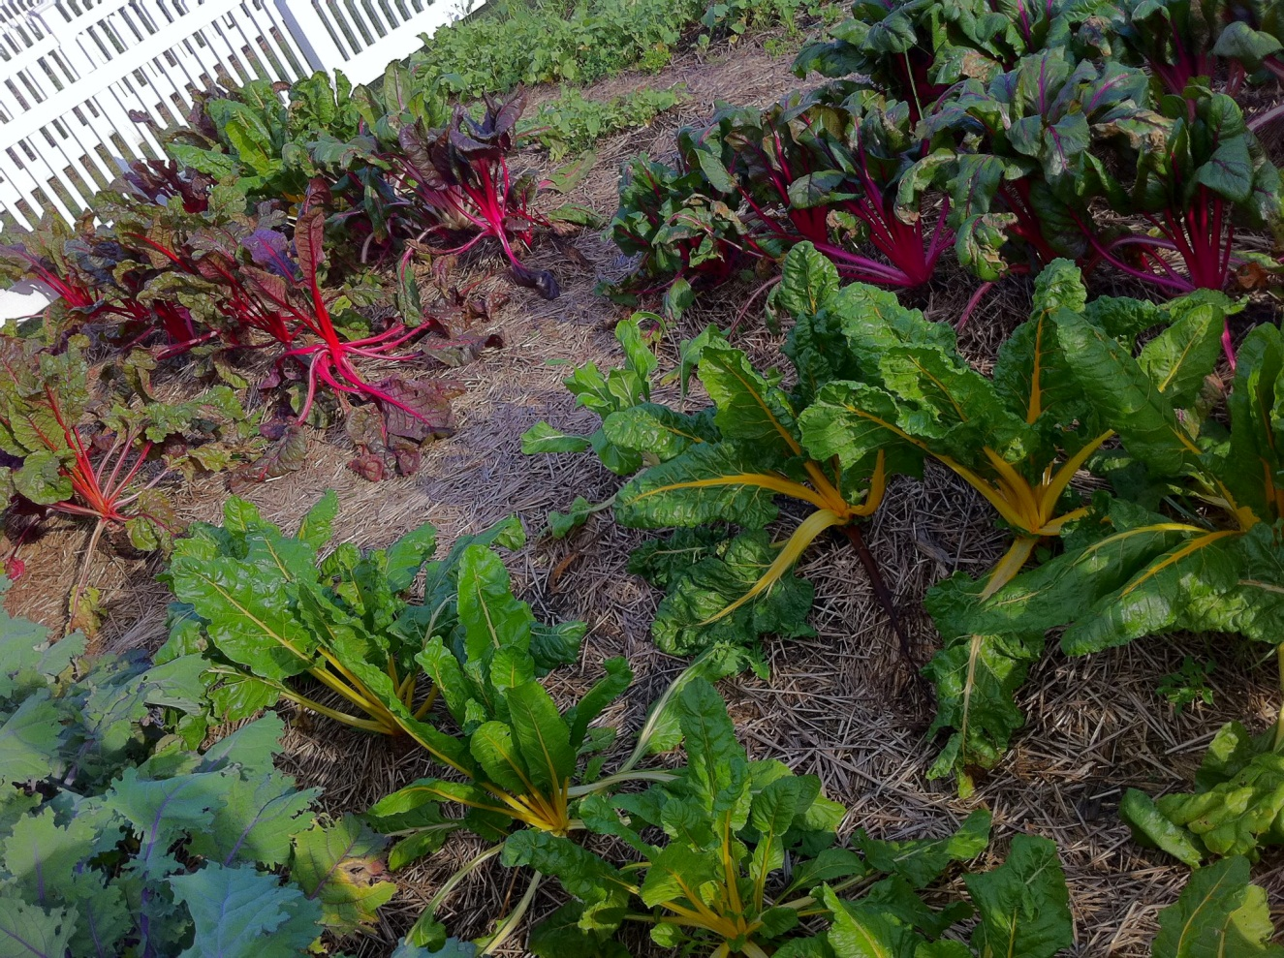
Food provenance – you know where it came from!
Our goal is to source foods from a 100-mile circle whenever possible.

Slide 10
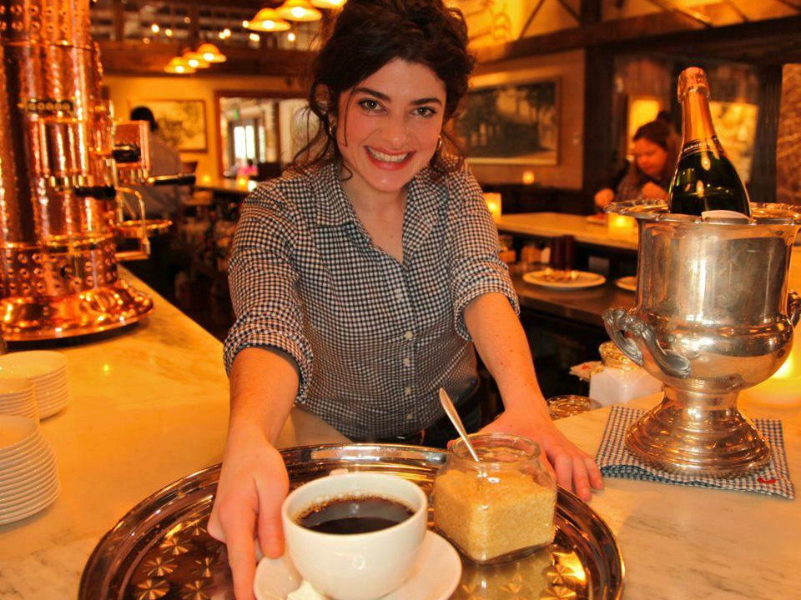
People with a passion for the details
We’ve built an energetic team of people who possess that most elusive but most treasured quality of all: “The Service heart.”

Slide 11
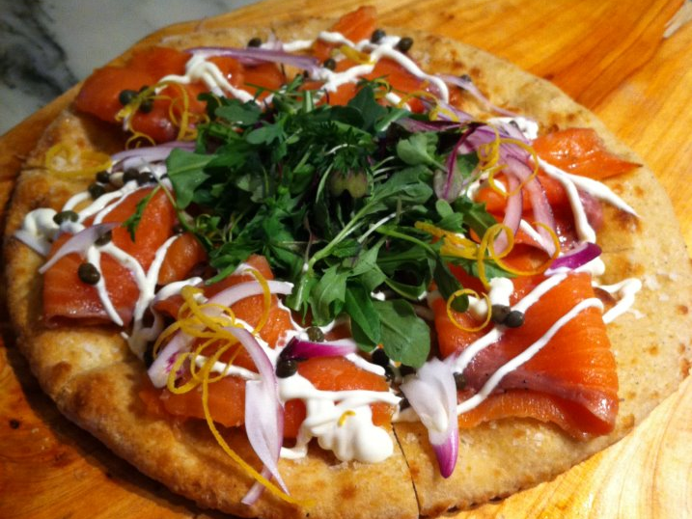
Organic where possible; gluten and peanut free options
We seek to offer a widening array of foods for those seeking specific dietary goals, while maintaining high standards for palatability and presentation.

Slide 12
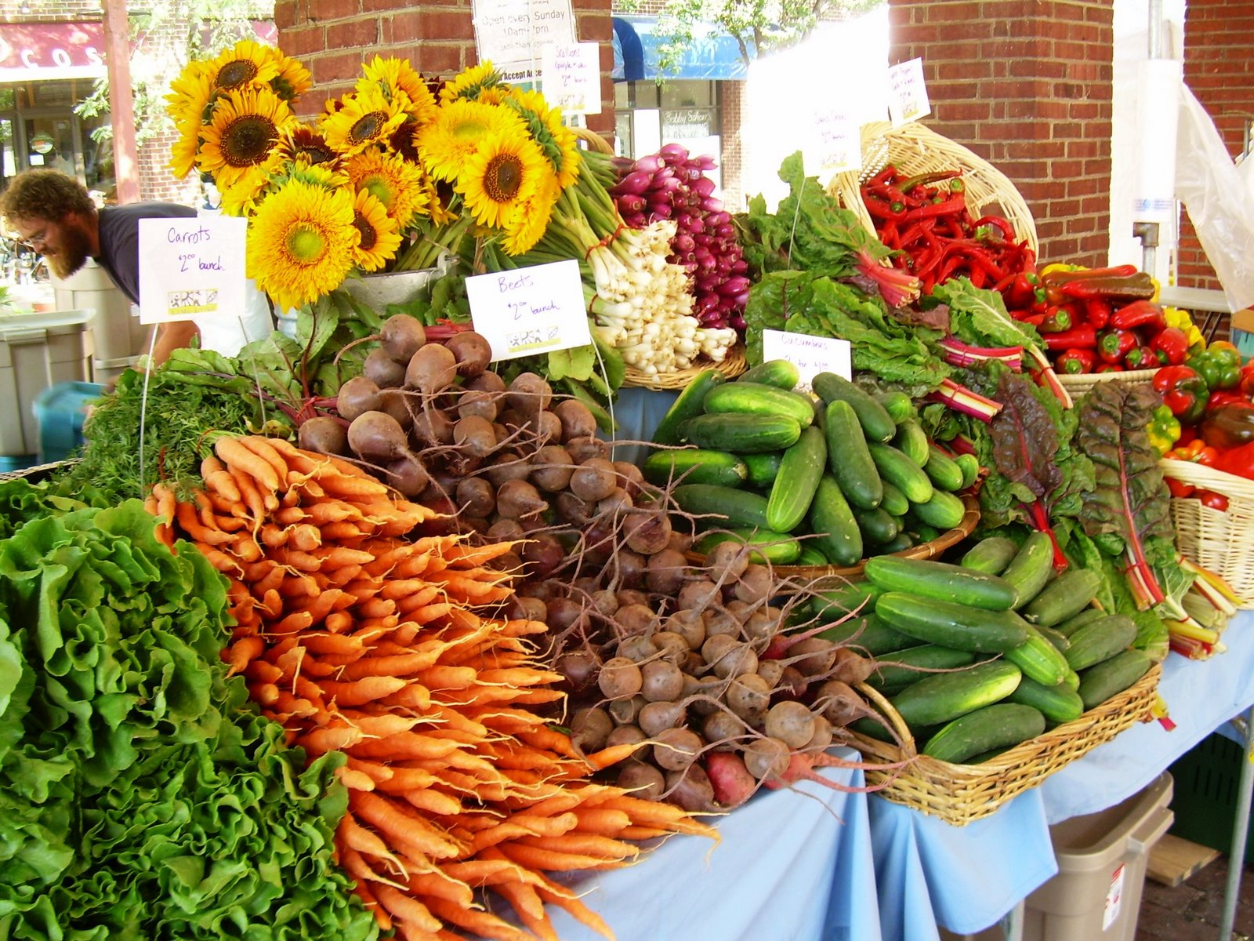
Local vendor partnerships preserve jobs and the land
The Farm Table sources produce, meats, dairy and more from growers and producers rom Bernardston and the immediate area whenever possible.

Slide 13
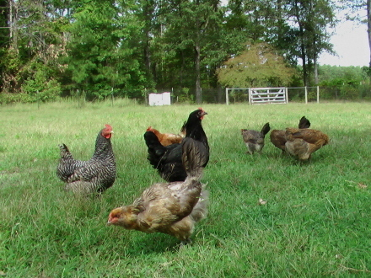
Ethical and sustainable practices
All our partners must adhere to practices that respect both the Earth and the food.

Slide 14
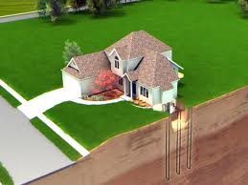
Geothermal energy powers our building
Consistent 55-degree water below the building provides heat in winter, cooling in summer, and is only part of our portfolio of “Green” practices.

Slide 15
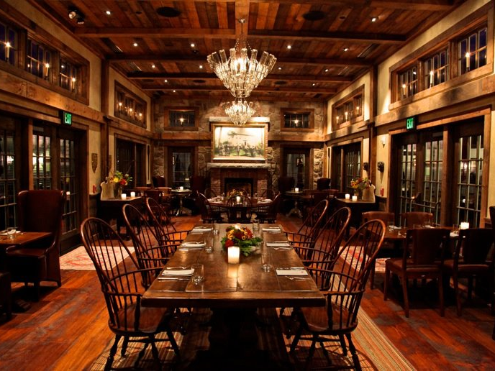
Re-purposed materials from original structure
Wherever possible, we salvaged materials from the original building and dairy barn on-site. Floor boards, beams, windows and even gravel were re-used in construction of The Farm Table.

Slide 16
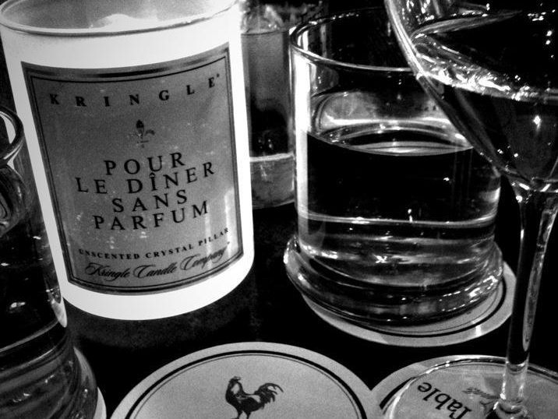
Innovative use of tableware, drinking vessels, etc.
Our tableware is recycled from venerable estates and grand hotels, and many of our drink ware items are the same vessels used for Kringle Candles.

Slide 17
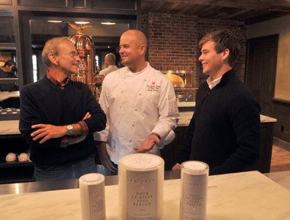
The vision thing
The Kittredge family believes that a quality experience, at the end of the day, is the only type of experience people want to have.

Slide 18
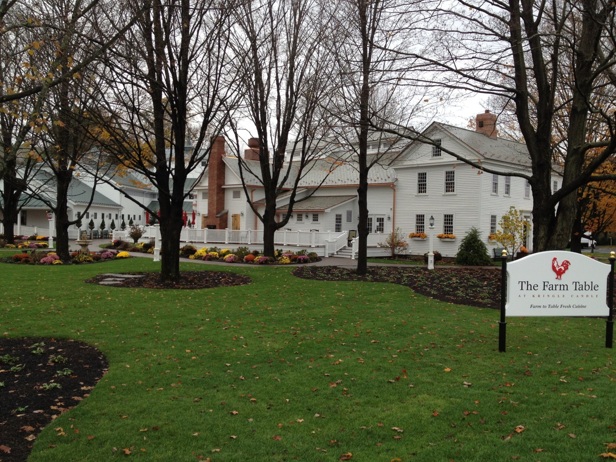
Our ever-present goal
“To nourish the body, educate the mind, and entertain the spirit”
– Executive Chef Brent Menke

Slide 19
Executive Chef
Brent Menke

